Slide 1
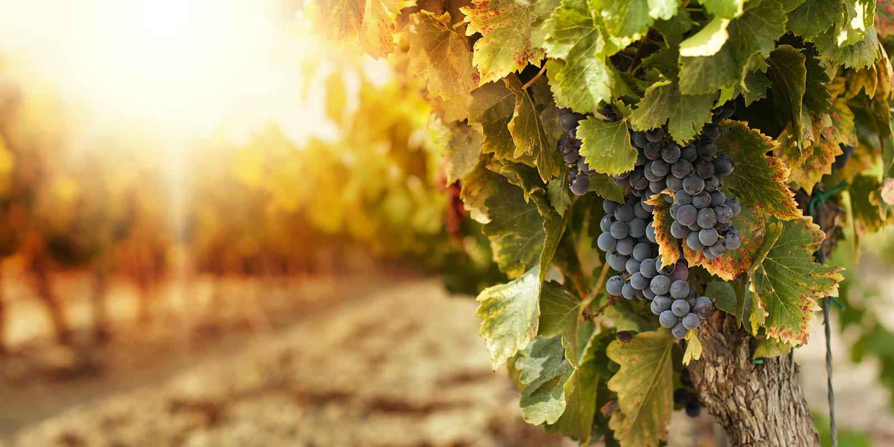
“Irrigation, when to irrigate using deficit and non-deficit and how to calculate your vines water needs”
Reinier van der Lee Temecula winegrower

Slide 2
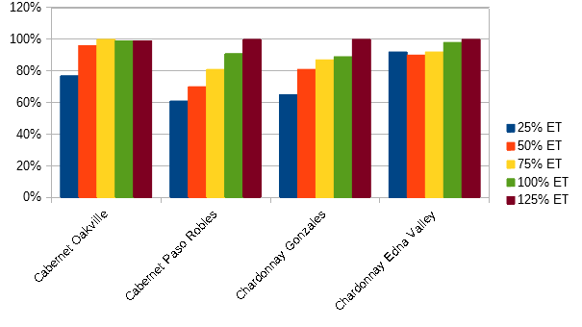
WHY WOULD YOU CARE?
Irrigation impacts yield
Less water > less yield
3.5 ton/ac @$1,750/ton
10% yield = $ 612/ac Roughly annual water cost
Source: Larry Williams , UC Davis 2001
http://www.practicalwinery.com/novdec01p42.htm

Slide 3
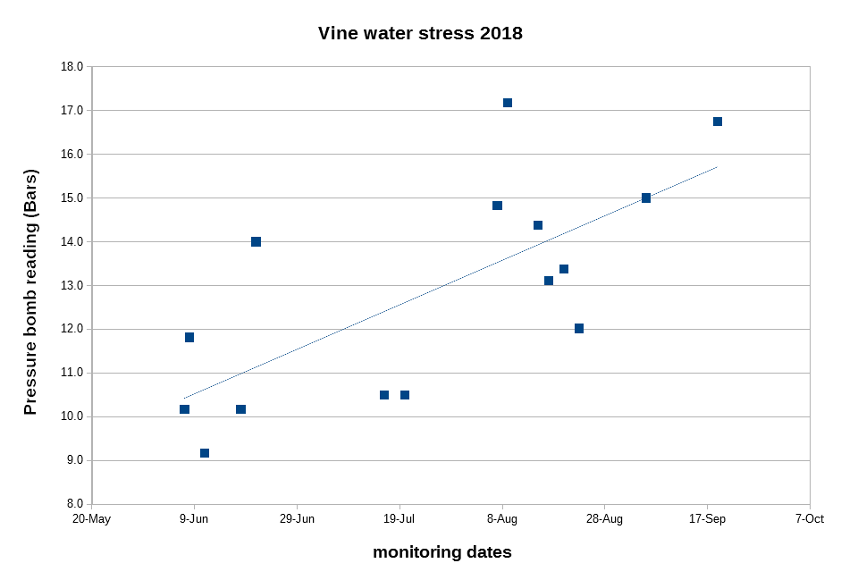
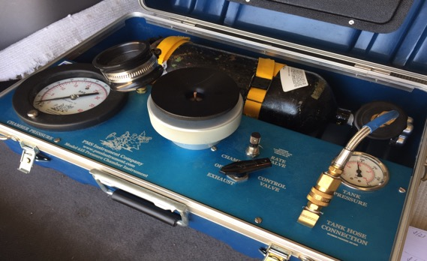
TEMECULA SEASON 2018
Pressure bomb tests
< 10 Bars: no stress > 14 Bars: high stress
Late deficit irrigation

Slide 4
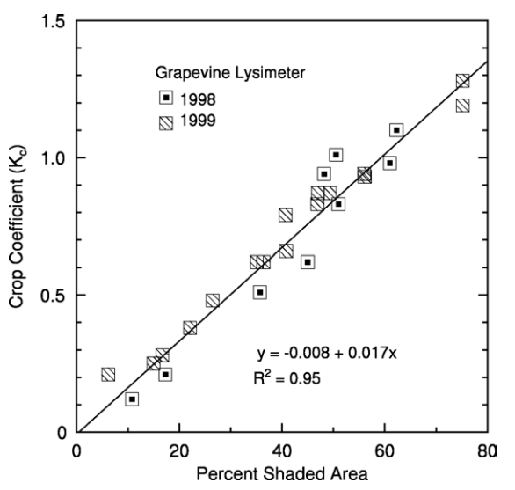
IRRIGATION THEORY
Evapotranspiration (ET)
= evaporation + transpiration
Reference ETo = lawn
Several sources for ETo
Adjusting ETo for other crops = ETc multiply ETo x Crop Coefficient
Williams and Ayers, 2015

Slide 5
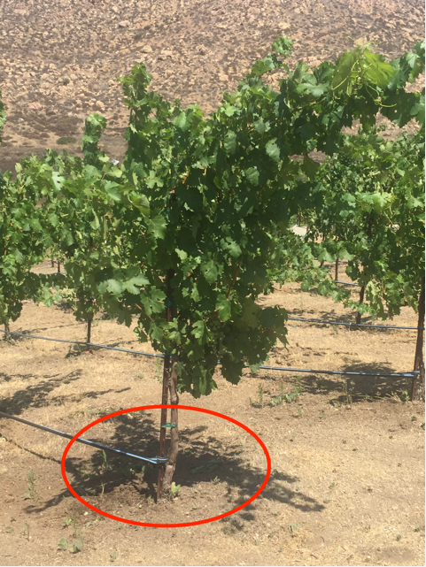
Crop Coefficient
Determine area per vine row width x vine spacing
Determine shaded area -VSP trained: canopy width x vine spacing -Vertical training: πr^2 (area of circle)
!! Shaded area will change during the season!!

Slide 6
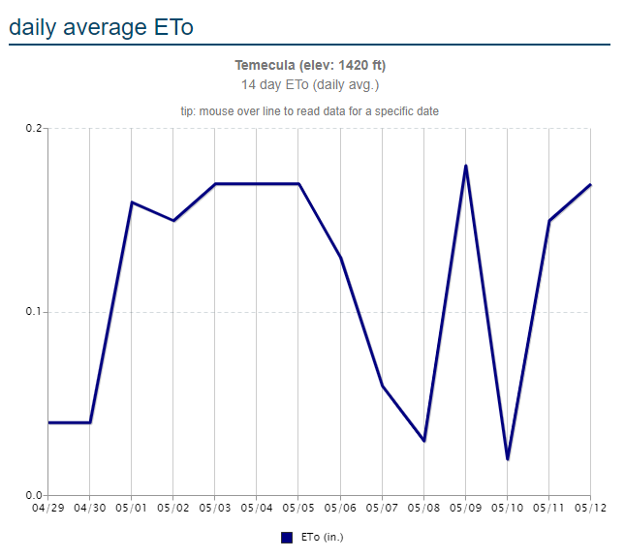
WHERE IS DAILY ETo?
WineBusiness.com https://www.winebusiness.com/weather/?weatherLocationId=15
CIMIS https://cimis.water.ca.gov/

Slide 7
Kc CALCULATION EXAMPLE
VSP trained vines
Row width: 9 feet
Vine spacing: 6 feet
Canopy shade width: 1 foot
Vine area: 9 x 6= 54 sqft
Canopy area: 1 x 6 = 6 sqft
Percent shaded area: 6/54 = 11% Kc = 11 x 0.017= 0.19

Slide 8
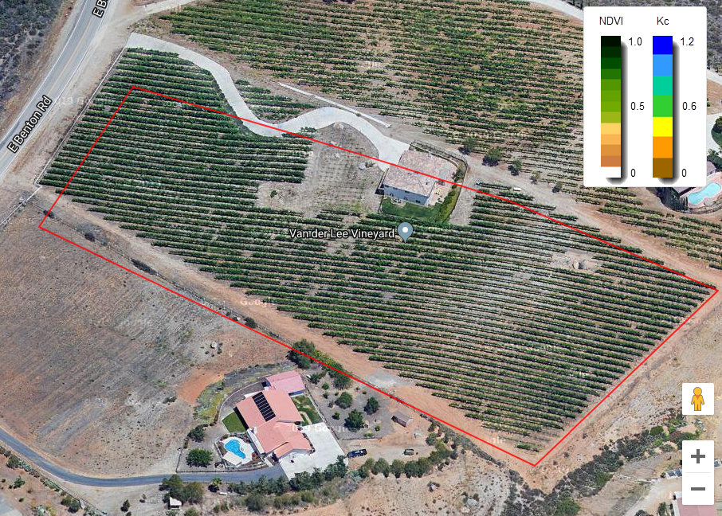
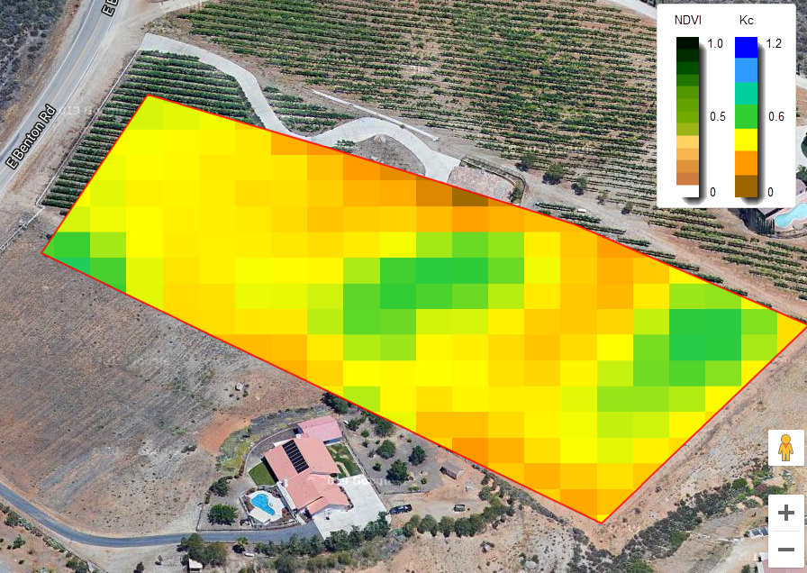
Kc BY SATTELITE
https://irrisat-cloud.appspot.com
Data May 1-5: is influenced by cover crop

Slide 9
IRRIGATION CALCULATION
Vine spacing: 9 x 6 feet (807 vines/acre)
ETo today = 0.17, Kc = 0.19 > ETc = 0.0323 inch/acre 0.0323 x 27,500 gal/acre= 888 gallons/ac
888/807 = 1.1 gallon vine/day
100% ET = replacing what was used the day before

Slide 10
SAME VINEYARD IN SUMMER
ETo JULY = 0.25, Canopy width 2.5 ft (28%) Kc = 0.48 > ETc = 0.12 inch/acre 0.12 x 27,500 gal/acre= 3300 gallons/ac
888/807 = 4 gallon vine/day
2 drippers @ 1 gal/hr = 2 hrs/day
Canopy width and ETo change

Slide 11
YOUR TURN
Your vineyard area per vine (row width x vine spacing)
Estimated canopy shade area (canopy width x vine spacing)
% shade per vine (canopy shade/area per vine)
Crop Coefficient (Kc) = % shade per vine x 0.017 ETc = ETo x Kc Etc x 27,500 gallons/acre = daily irrigation per acre
Irrigation per vine = irrigation/acre : vines/acre
Irrigation time: gallons/vine : dripper flow rate

Slide 12
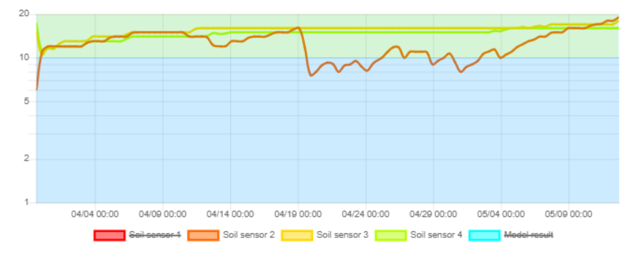
CHECK ET WITH SOIL MOISTURE
Correct 100% ET irrigation should result in constant soil moisture

Slide 13
DEFICIT IRRIGATION RECOMMENDATION
ALL SEASON 100% ET
FOR OPTIMAL FRUIT QUALITY 85% ET BETWEEN FRUIT SET AND VERAISON (15% LESS YIELD)
OVER IRRIGATE BEFORE HEAT WAVE

Slide 14
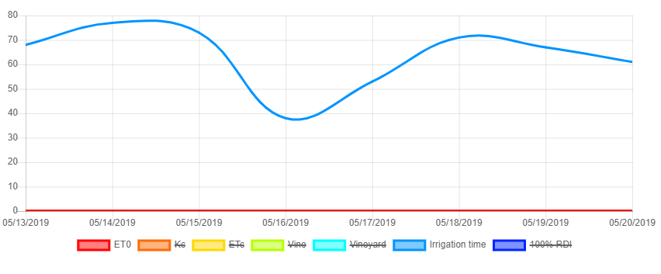
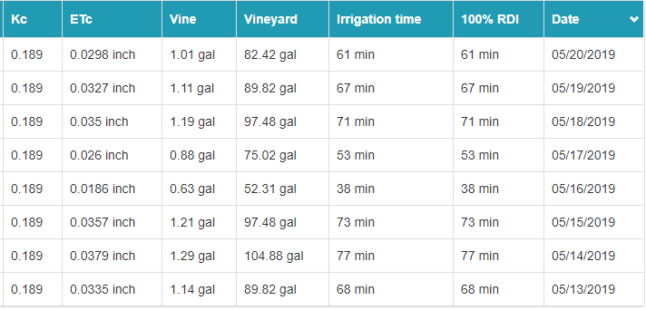
SOFTWARE TO THE RESQUE
Evineyard software Calculates ETc and irrigation times

Slide 15
Thank You
949-302-9339
reinier@vinduino.com

